Slide 1
BLOCPLAN
Submitted to:
Dr. Abdulaziz Al-Tamimi
Presented by
MUHAMMAD DZULQARNAIN AL FIRDAUSI 438106660

Slide 2
Outline
Overview
Literature Review
Methodology
Discussion
Conclusion

Slide 3
Overview
Facility layout problem (FLP) is a fundamental problem which seeks to deal with several layout problems such as material handling costs, work in process, lead times, and utilize existing space more effectively
It is noteworthy to know that material handling cost constitutes 20–50% of the total operating expenses in manufacturing environments which can considerably be reduced through designing an efficient layout configuration
The objective of facility layout analysis is to develop layouts which maximize the advantageous placement while minimizing the disadvantageous placement of departments
Computers have been utilized since the 1960’s and 1970’s to assist with the high computational demands required for the calculations necessary for producing these types of facility layouts

Slide 4
Overview
BLOCPLAN is an interactive program developed by Donaghey and Pire that can develop a layout & has a number of useful features
It uses construction and improvement algorithm
Assessment of a layout is distance-based and adjacency-based objective (R-score)
Departments are in bands (2 or 3 bands), but the band width may vary
All departments are rectangular

Slide 5
Literature Review
No. | TITLE | DESCRIPTION & ABSTRACT | TECHNIQUE | Year of Publication
1 | Production facility layout by comparing moment displacement using BLOCPLAN and ALDEP Algorithms (M Tambunan) | The purpose of this study is comparing movement displacement using BLOCPLAN and ALDEP algorithm in order to redesign existing layout. | BLOCPLAN and ALDEP | IOP Conference Series: Materials Science and Engineering 309 012032 (2018)
2 | Blocplan for windows: Computer aided facility layout methodology and enhancements (Donaghey) | BLOCPLAN for Windows is an evolutionary development of its DOS version. It is able to result more alternative layout, e.g. for a nine department problem the number of possible layouts is close to 20 million | BLOCPLAN | Proceedings of the 2007 Industrial Engineering Research Conference

Slide 6
Literature Review
No. | TITLE | DESCRIPTION & ABSTRACT | TECHNIQUE | Year of Publication
3 | FLEXPERT: facility layout expert system using fuzzy linguistic relationship codes (Badiru) | An expert system generates facility layout alternatives based on the fuzzy logic theory and the results provided by BLOCPLAN (software for buildingplant layouts) | BLOCPLAN Fuzzy Logic | IIE Transactions, 28, 295–308 (1996)
4 | Production facility layout design using blocplan algorithm (Puspita) | The implementation of the BLOCPLAN algorithm to improve the production facility layout. Total movement moment and the Benefit-cost ratio (BCR) are used to compare existing and alternative layout | Benefit-cost ratio (BCR) Blocplan | American Scientific Publishers (2015)
5 | Comparing alternative plant layouts based on Craft and Blocplan algorithms (Leonardo) | The paper compares two proposed layout models using CRAFT and BLOCPLAN algorithms. An initial layout is analyzed and the two algorithms are applied to the layout therefore the best score resulted from a layout is selected. | Craft and Blocplan | Metris Journal Vol. 15 (2014) 55–64

Slide 7
BLOCPLAN
Pros | Cons
Providing the square shape for each department Resulting up to 20 alternatives with different scores for a layout Combining qualitative and quantitative data Able to change the position of departments manually | 3 tiers may be limiting Can lead to poor department shapes (long and skinny departments) Not providing the total movement score for a layout

Slide 8
Methodology
The user provides the required area
The user also gives the desired length to width ratio (L/W) for the layout
The length and the width of the facility can be calculated using the L/W ratio and the total area
BLOCPLAN utilizes the Relationship chart method

Slide 9
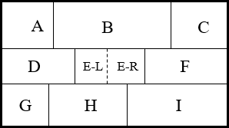
Width of the band
Example:
We have 9 departments
Length of Area = 20
Total Area for 1st band (upper) = (Area A + Area B + Area C) = (45 + 80 + 45) = 170
x = 170/20 = 8.5
20
x

Slide 10
Length of the department
Example:
Width of 1st band = 8.5
Length of department A = (Area A / 8.5)
y = 45 / 8.5 = 5.3
y
8.5

Slide 11
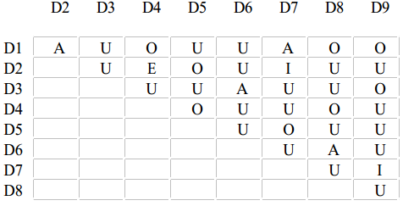
Adjacency Score
Code | Description | Score
A | Absolutely Essential | 10
E | Essential | 5
I | Important | 2
O | Ordinary Closeness OK | 1
U | Unimportant | 0
X | Undesirable | -10
Adjacency score for D3 =
U + U + U + U + A + U + U + O
= 0 + 0 + 0 + 0 + 10 + 0 + 0 + 1
11

Slide 12
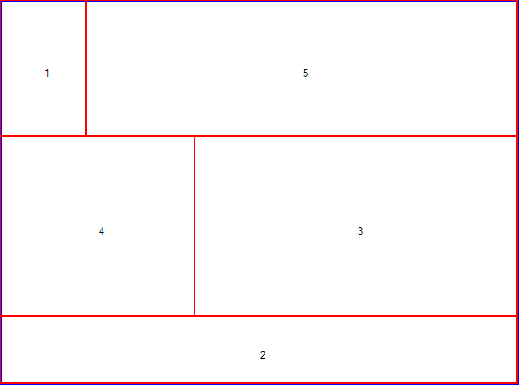
Generating Initial Random Layout
Step
Deciding number of department per band (min=1, max=6)
From upper band, randomly place a department regarding to the number of department for this band
Calculate width of the band
Calculate length of each department

Slide 13
Automatic Search Algorithm

Slide 14
Automatic Search Algorithm
Step 1: Let S be the initial solution provided by the user and z is its distance score. Set S* = S, z* = z, i = 1; j = i + 1 = 2.
Step 2: Consider the exchange between the positions of departments i and j in the solution S. If the exchange results in a solution S′ that has an OFV z′ < z*, set z* = z′ and S* = S′. If j < mn, set j = j + 1; otherwise, set i = i + 1, j = i + 1. If i < mn, repeat step 2; otherwise, go to step 3.
Step 3: If S ≠ S*, set S = S*, z = z*, i = 1, j = i + 1 = 2 and go to step 2. Otherwise, return S*as the best solution to the user. Stop

Slide 15


Score of Layout
Philosophy: departments that have an "A" relationship will be as close together as possible. Departments with an "X" relationship will be as far apart as possible.
Rel-dist score =
Where:
R_{ij} is the numeric value assigned to the relationship code between departments i and j
n is the total number of departments
d_{ij} is the rectilinear distance between the centers of departments i and j

Slide 16
Score of Layout
Lower bound: arranging elements of the ﬂow vector in nonincreasing order and the distance vector elements in nondecreasing order
Upper bound: arranging elements of the ﬂow vector in nonincreasing order and the distance vector elements in nonincreasing order

Slide 17
Study Case
For implementing the new version of BLOCPLAN, we do a small research for getting the appropriate data. We get data from Kustriyanto paper which studied layout improvement in strategic manufacturing company, ammunition division and we will compare the result from the paper with our result.

Slide 18
Study Case
Problem Statement
How to improve the existing layout of the company by using BLOCPLAN algorithm.

Slide 19
Study Case
Collecting data
Existing layout of the department in the company. This department has several production lines with different machine generation/ technology and capacity.
Those machines are grouped based on their process type (Figure 12). The groups are:
Cell 1 : Drawing I, drawing II, degreasing
Cell 2 : Drawing I, drawing II, cutting
Cell 3 : Annealing dan cleaning
Cell 4 : Indenting, necking, drilling
Cell 5 : Cleaning, drilling, grooving
Cell 6 : Gauging
Cell 7 : Annealing
Cell 8 : Visual inspection

Slide 20
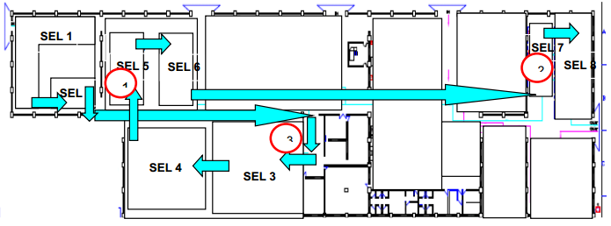
Existing Layout

Slide 21
Area of each machine cell
No. | Cell | Cell Name | Dimension, (l x w) m | Area m² | Scale :10
1 | Cell 1 | Drawing | 15,66x9,00 | 140,94 | 14
2 | Cell 2 | Cutting | 15,66x4,74 | 74,23 | 7.4
3 | Cell 3 | Annealing and cleaning | 21,63x15,63 | 338,08 | 33.8
4 | Cell 4 | Indenting, necking, drilling | 16,72x15,63 | 261,33 | 26.1
5 | Cell 5 | Cleaning, Drilling, grooving | 11.1x11,16 | 123.89 | 12.3
6 | Cell 6 | Gauging | 15,60x5,58 | 87,06 | 8.7
7 | Cell 7 | Annealing | 4,89x11,30 | 55,26 | 5.5
8 | Cell 8 | Visual inspection | 7,65X14,19 | 108,55 | 10.8

Slide 22
Relationship chart
Relationship chart for ammunition division
Cell | 1 | 2 | 3 | 4 | 5 | 6 | 7 | 8
1 |  | A | O | X | X | X | X | X
2 |  |  | A | X | X | X | E | U
3 |  |  |  | A | I | U | X | X
4 |  |  |  |  | A | E | U | U
5 |  |  |  |  |  | A | I | E
6 |  |  |  |  |  |  | A | U
7 |  |  |  |  |  |  |  | A
8

Slide 23
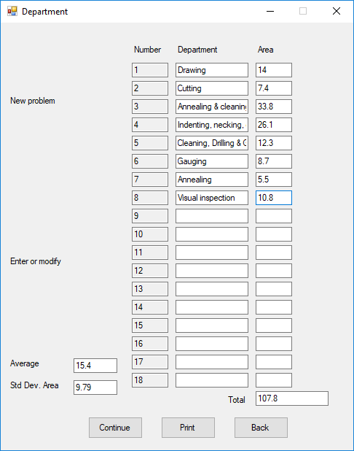
Developed BLOCPLAN
Step 1: Input department data
The new features here are the Blocplan is able to show the average, standard deviation, and total area of departments those are being input.

Slide 24
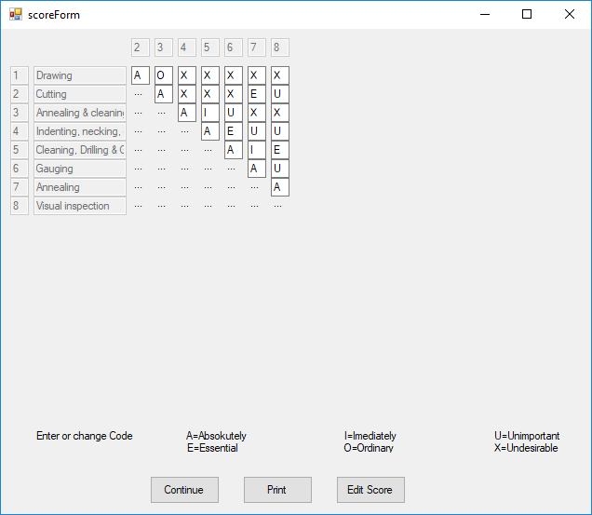
Relationship chart
Step 2:
Set the Relationship chart based on the data acquired

Slide 25
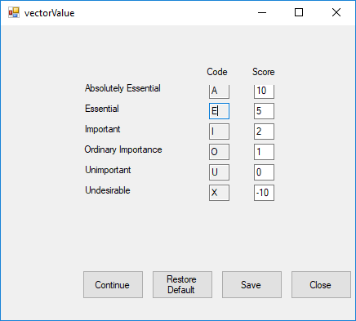
Scoring for each relationship
Step 3:
Check the score for each code whether there is a change or just using the default score. In this case study we use the default score provided by Donaghey.

Slide 26
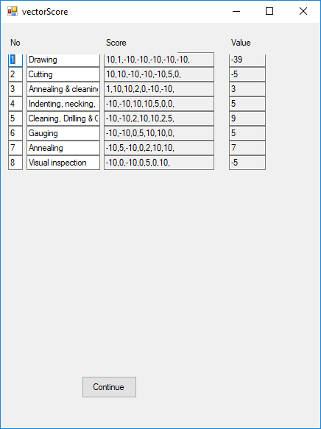
Scoring for each relationship
Step 4:
We can get the score for each department after we click on the continue button from the relationship chart.

Slide 27
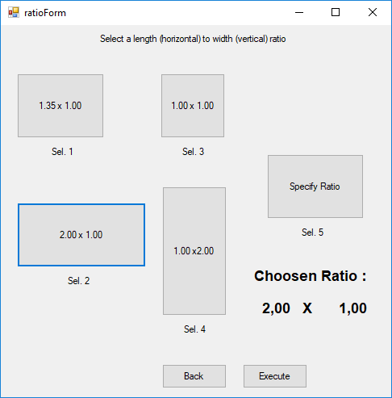
Area Ratio
Step 5:
From the relationship score, we will select one of the available ratios for the area. We choose the ratio 2.00 x 1.00 (selection 2) for this case, based on the actual data of ammunition department.

Slide 28
Area Ratio
Step 6:
Execute the ratio. The randomized department location in layout will be appeared.

Slide 29
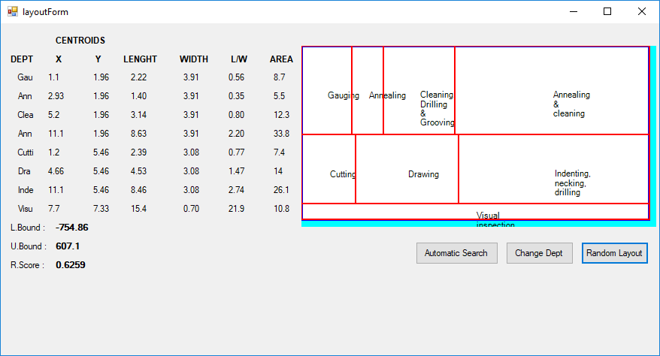
Generating initial random layout

Slide 30
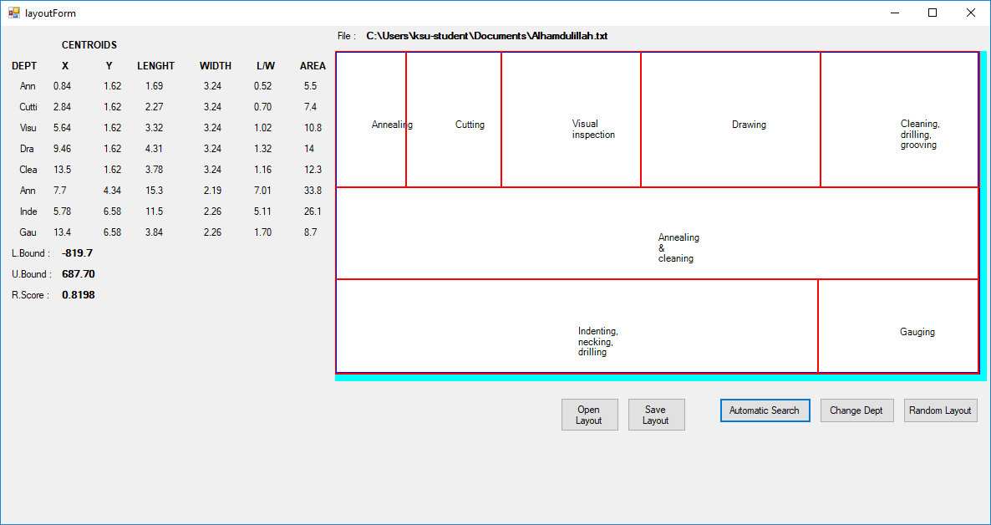
Improving the layout
Step 7:
Do automatic search algorithm with clicking on the Automatic Search. This button makes a hundred replication of change. Whenever it gets a higher R.Score, it keeps the change and continues the search.

Slide 31
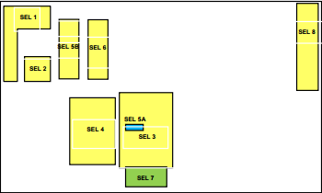
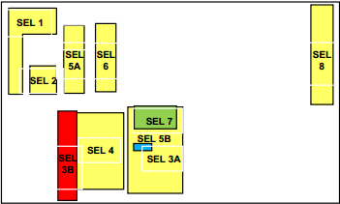
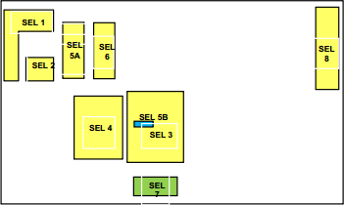
Alternative layout from paper
Alternative layout 1 Alternative layout 2 Alternative layout 3

Slide 32
R.Score comparison
No. | Alternative Layout | R.Score
1 | Alternative 1 | 0.67
2 | Alternative 2 | 0.67
3 | Alternative 3 | 0.33
4 | Developed Blocplan | 0.82

Slide 33
Discussion
Result from the paper has a relative smaller value than the result from new version of Blocplan. This is because:
Methodology of paper for improvement is placing the cell to a certain location and then calculate the R.Score with Blocplan
Blocplan ability of automatically searching a higher value of R.Score is not applied.

Slide 34
Conclusion
Blocplan is able to deal with the location size of workplace and keep it rectangular
Several features that user need are available in this version of Blocplan such as: information about total area when department data form is on, average and standard deviation and department change one by one with pairwise exchange
Result of the new version of blocplan is better than result of the paper due to the difference in method for applying the Blocplan

Slide 35
THANK YOU

